Slide 1






Altran Group Presentation
May 2018

Slide 2
1.
Combined company Profile

Slide 3

Altran is the world leader in engineering and R&D services
Altran is the undisputed global leader in Engineering
and R&D services (ER&D)
45,000
EMPLOYEES
€ 2.9 bn
2017 REVENUES*
30+
COUNTRIES
* Based on combined LTM Jun-17 revenue pro-forma of €2.9 billion: for Altran pro-forma for full-year impact of acquisitions and for Aricent pro-forma for full-year impact of software deals

Slide 4







Unmatched footprint in ER&D services
Scale and scope
Leadership across industries
Superior expertise in key technology domains
Premier ER&D global delivery
45,000 Employees
25 000+
On-shore Engineers in
30 countries
Aerospace,
Defense
#1
Semiconductors & & Electronics
#1
Design
Product Development
Mechanical Engineering
System Engineering
Digital & Software development
€2.9n Revenues*
15 000+
Near and offshore engineers
Communications
#1
Automotive
Top 5
#1 Worldwide
#1 in Europe #1 in the US**
5 Global Delivery Centers
India
Eastern Europe
North Africa
Portugal
North America nearshore
Life Sciences
Top 5
Software
& Internet
Top 5
Orange font: Aricent impact
* Based on combined LTM Jun-17 revenue pro-forma of €2.9 billion: for Altran pro-forma for full-year impact of acquisitions and for Aricent pro-forma for full-year impact of software deals
** Excluding Financial Services

Slide 5












Leadership across 3 domains and 10 industries
Product Design & Engineering
Digital & Software
Manufacturing & Operations
Accelerate the design and development of tomorrow’s products & services
Foster digital transformation at scale throughout value chains and ecosystems
Increase industrial performance and manage transition to
Industry 4.0
Automotive
Aeronautics
Space, Defense
& Naval
Railway, Infra & Transportation
Energy & Industrials
Life Sciences
Communications
Semiconductors
& Electronics
Software & Internet
Finance &
Public Sector

Slide 6
Our industries
10 Industries
Delivering high value innovations across
2017 REVENUE BREAKDOWN
10%
Finance &
Pubic Sector
17%
Automotive
15%
Hi-tech &
Software
Space, Defense
& Naval
Railway, Infra & Transportation
Energy & Industrials
€2.9B
(proforma)
19%
Aerospace, Defence & Rail
Automotive
Aeronautics
21%
Telecom &
Media
18%
Energy, Industrials & Life Sciences
Life Sciences
Communications
Semiconductors
& Electronics
Software & Internet
Finance &
Public Sector

Slide 7






























Working with global innovation leaders
Strong reach within the top 20 global R&D spenders…
…and across all verticals
R&D SPEND RANK ‘16 | COMPANY | CLIENT?
1 |  | ✓
2 |  | ✓
3 |  | ✓
4 |  | ✓
5 |  | ✓
6 |  | ✓
7 |  | ✓
8 |  | ✓
9 |  | ✓
10 |  | ✓
R&D SPEND RANK ‘16 | COMPANY | CLIENT?
1 |  | ✓
2 |  | ✓
3 |  | ✓
4 |  | ✓
5 |  | ✓
6 |  | ✓
7 |  | ✓
8 |  | ✓
9 |  | ✓
10 |  | ✓
Automotive
Aerospace, Defence & Rail
Energy, Industrials & Life Sciences
Communications
Hi-tech &
Software
Finance &
Public Sector

Slide 8


Our global reach
Europe
17,000
Operations in
France
11,000
30+
countries
North America
1,600
Asia
14,000
MEA
1,500
Employees
45,000+

Slide 9

Our people
45 000
EMPLOYEES AS OF TODAY
80
NATIONALITIES
RECRUITMENTS
MORE THAN
8 000
CONSULTANTS RECRUITED
PER YEAR
90%
ENGINEERS
<32 y/o
AVERAGE AGE

Slide 10
2.
Aricent highlights
(for Altran)

Slide 11
Aricent: a digital leader in design and engineering services
Aricent is a leading provider of ER&D services
Global engineering services and design leader
Key business differentiators:
World class design and customer experience capabilities
Deep expertise in key emerging technologies
Scalable and industrialized delivery model
Market leader in shaping transformational deals with clients
Successful IP-based model
Long-standing relationships with top technology market leaders
Close to 70% of revenues in the North American market
Strong leadership team with deep expertise and longstanding experience in large-scale organizations
Global
delivery model
24 engineering centers and design studios worldwide
Premier capabilities in India (8,500 engineers)
~10,500 employees of which:
~9,200 engineers
~600 designers

Slide 12
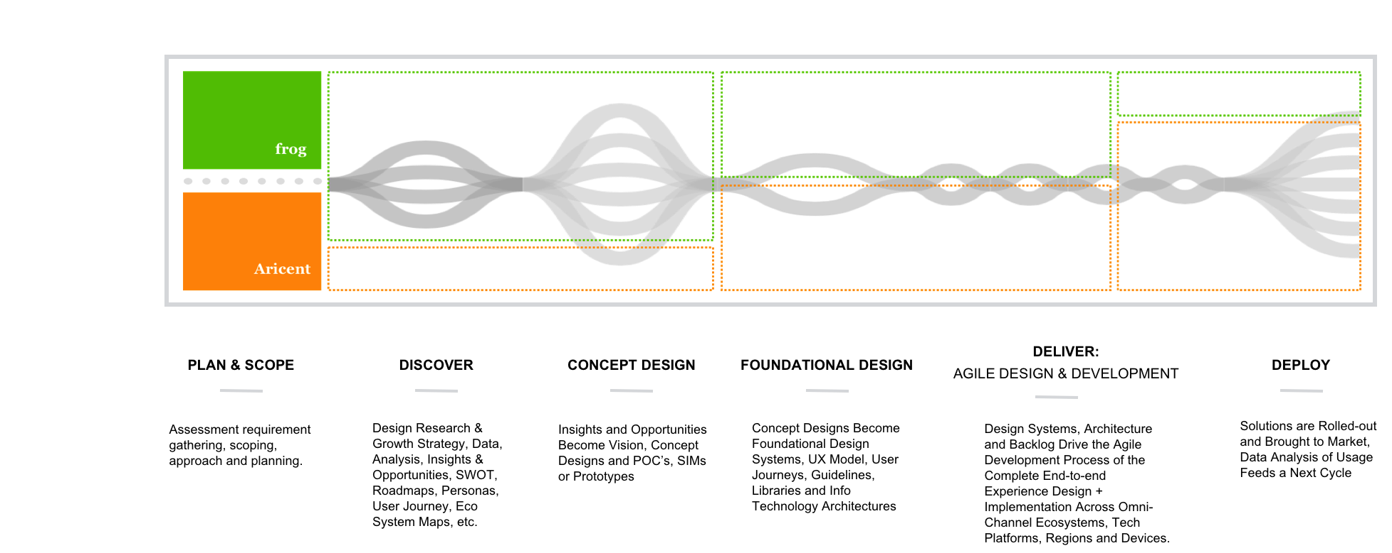
Design-integrated engineering
Design the right thing + Engineer the thing right to bring intelligence to the experience

Slide 13







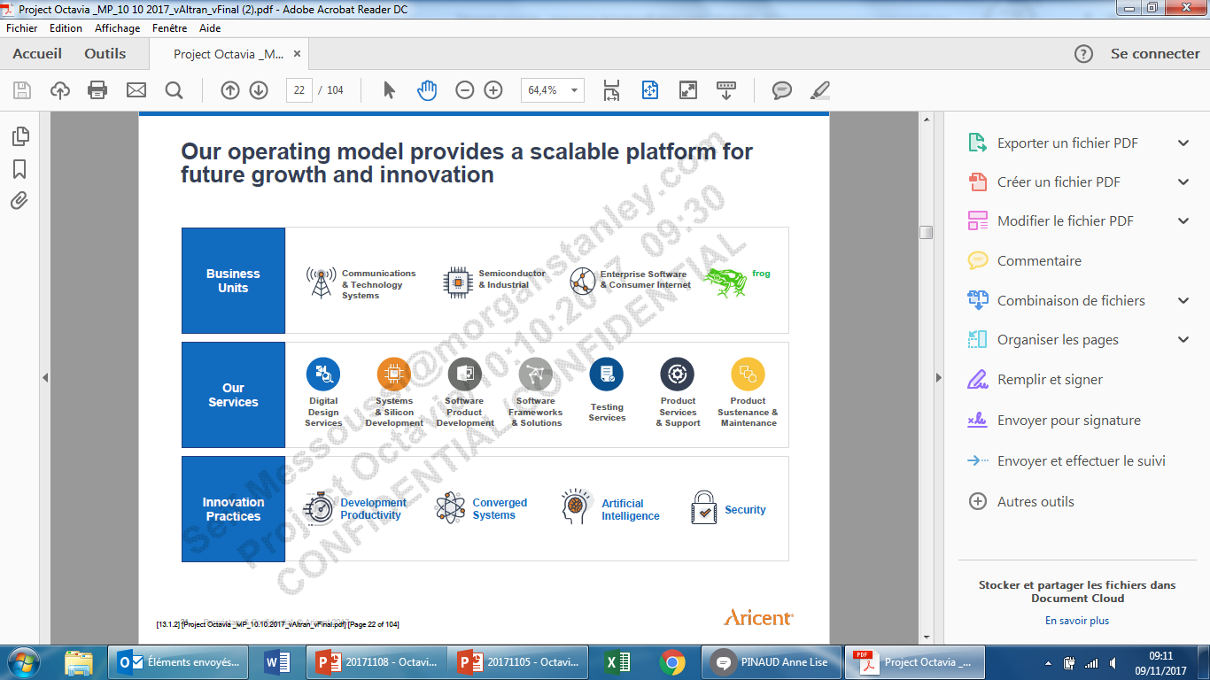







Integrated capabilities supporting market leadership
Business lines
(as % of revenue*)
Coms & Tech systems
Semiconductor
& Industrial
Enterprise software & Consumer internet
Frog design
Services
Digital design services
Systems & Silicon development
Software product development
Software
frameworks & Solutions
Product services
& Support
Product sustenance & Maintenance
Testing services
Innovation practices
Development Productivity
Converged Systems
Artificial Intelligence
Security
Key clients
* Revenue breakdown as of March 2017 LTM

Slide 14















Aricent Service Lines support our Industry Strategies
ENTERPRISE
SOFTWARE
CONSUMER &
INTERNET SERVICES
NETWORK EQUIPMENT PROVIDERS
TECHNOLOGY
SYSTEM
PROVIDERS
COMMUNICATION
SERVICE PROVIDERS
SEMICONDUCTOR
INDUSTRIAL
AUTOMOTIVE, CONSUMER,
HEALTHCARE, FINANCIAL
Digital Design Services
Software Product Development
Systems & Silicon Development
Software Frameworks & Solutions
Testing
Services
Product Services
& Support
Product Sustenance & Maintenance

Slide 15

Global presence
Newbury
Amsterdam
Boston
London
Nuremberg
New York
Milan
Munich
San Francisco
Santa Clara
San Jose
Dallas
Raleigh
Rome
san Diego
Lafayette
Shanghai
Austin
shenzhen
Gurgaon
Hyderabad
Bengaluru
Chennai
Headquarters
frog Studios
Engineering Centers
Sydney

Slide 16
3.
Altran additional highlights
(for Aricent)

Slide 17


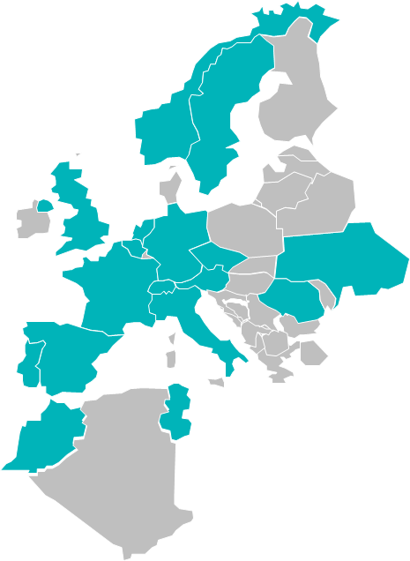
















A global leader with worldwide operations
900
550
650
1 500
3 200
Operations in
10 900
20+
countries
1 000
1 700
200
800
450
2 900
Employees
1 400
3 600
33 000+
3 800

Slide 18
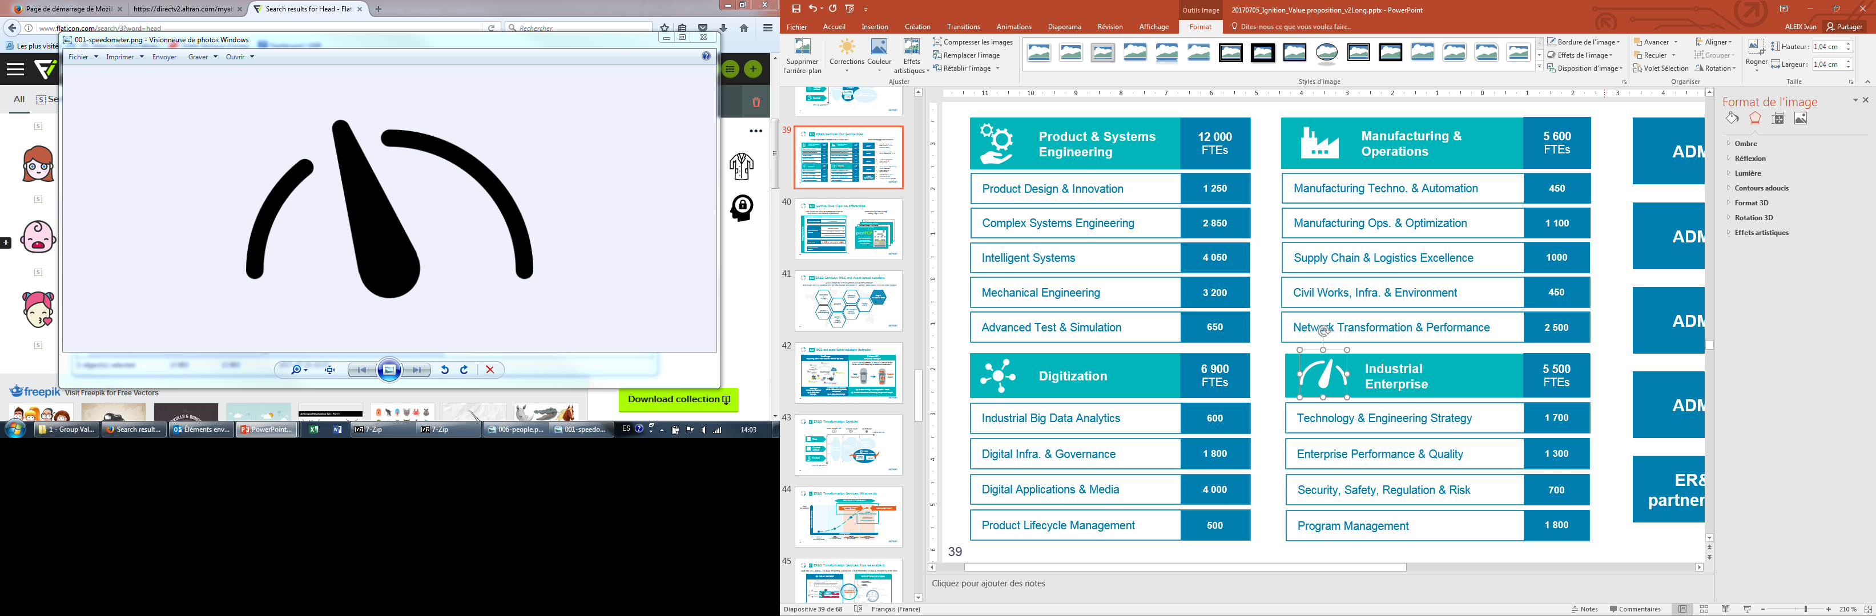
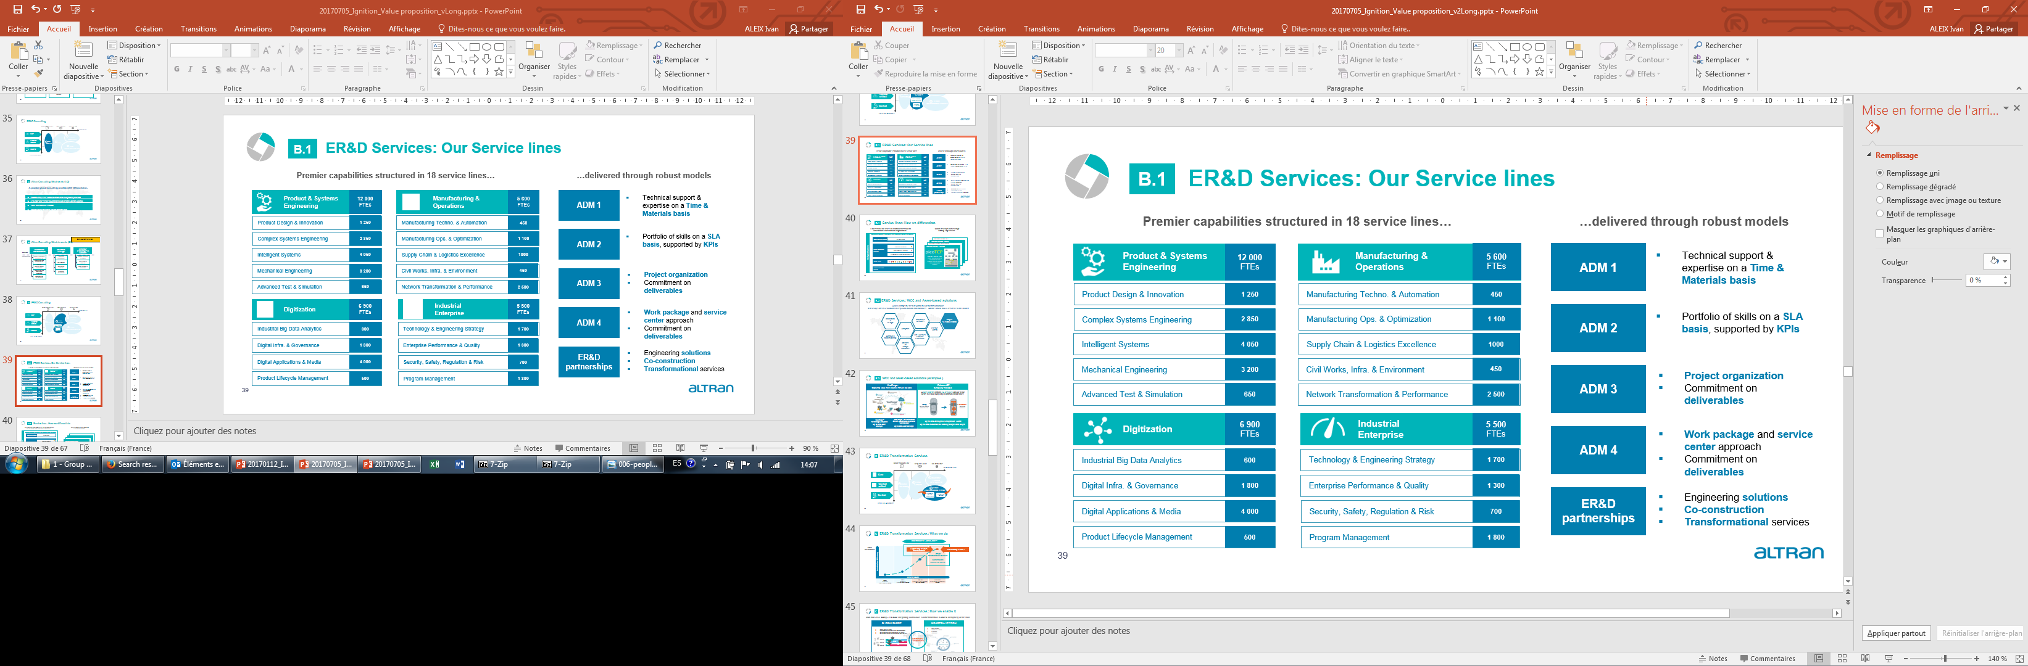
Superior engineering capabilities
33 000+ Altran experts
12 600 engineers
Product & Systems Engineering
Manufacturing & Operations
5 900 engineers
Product Design & Innovation
Manufacturing Techno. & Automation
Complex Systems Engineering
Manufacturing Ops. & Optimization
Intelligent Systems
Supply Chain & Logistics Excellence
Mechanical Engineering
Civil Works, Infra. & Environment
Advanced Test & Simulation
Network Transformation & Performance
Digitization
7 300 engineers
Industrial Enterprise
5 200 engineers
Industrial Big Data Analytics
Technology & Engineering Strategy
Digital Infra. & Governance
Enterprise Performance & Quality
Digital Applications & Media
Security, Safety, Regulation & Risk
Product Lifecycle Management
Program Management

Slide 19
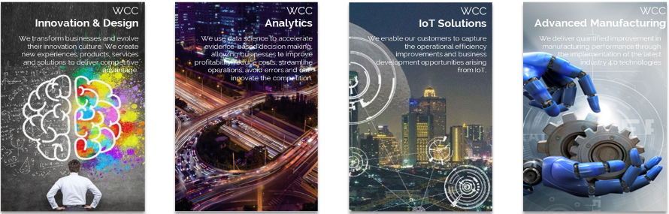

























Leading expertise and innovation
7
World Class
Centers
35+ Certifications
>100
Expertise Centers
>140 Active research programs
…

Slide 20
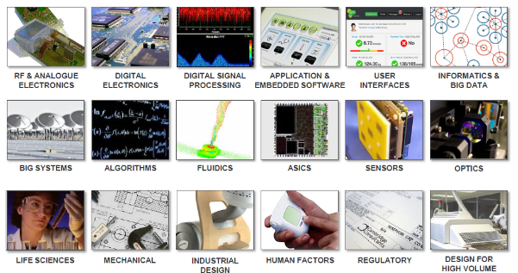
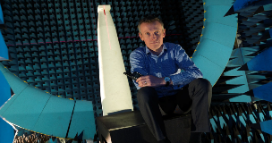
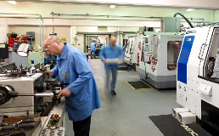
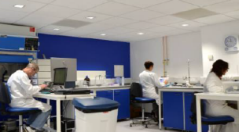

Innovative Product Development
High-level scientists with world-class product development expertise across several areas…
…And unique facilities & labs
Stargate Antenna Chamber
Mechanical fabrication facilities
Climate controlled Class II labs

Slide 21
4.
Industry expertise & footprint

Slide 22









































Strategic domains for each of our industries
Automotive
Autonomous Driving
& Connectivity
Powertrain &
Electro mobility
Complete Vehicle
Development
Aeronautics
Advanced aircraft development
Production ramp-up & Industry 4.0
Digital services & connectivity
Space, Defense & Naval
Advanced development & production
Disruptive services & connectivity
Security
Rail, Infrastructure & Transportation
Digitization & Train control
Train design and innovation
Infrastructure project engineering
Energy Digitization
Energy & Industrials
Industrial Engineering
Energy Transition
Life Sciences
Innovative Patient Centric Product Development
Life Sciences
Digitization
Industrial Performance & Regulatory Compliance
Communications
Telecom Services
OTT & Internet Services
IoT & Analytic Services
Semiconductors & Electronics
Silicon Design
Platform Design
Product Design
Software & Internet
Enterprise Software
Consumer Software
Internet
Finance & Public Sector
Digital Transformation
Core Business Solutions & Regulatory Compliance
Operational Excellence

Slide 23











Automotive footprint
30+
YEARS PRESENCE IN AUTOMOTIVE
7 800+
DEDICATED ENGINEERS
€500m+
2017 TURNOVER
KEY CLIENTS
A partner of major OEMs and Tiers1 industry players in Car Passengers, Commercial Vehicles and Agriculture segments

Slide 24



Aeronautics footprint
30+
YEARS PRESENCE IN AERONAUTICS
3,700+
DEDICATED ENGINEERS
€300m+
2017 TURNOVER
KEY CLIENTS
A partner of major OEMs and Tiers1 industry players in Aircraft manufacturing, MRO & Completion, operators & airliners

Slide 25












Space, Defense & Naval footprint
30+
YEARS PRESENCE
2,000+
DEDICATED ENGINEERS
€175m+
2017 TURNOVER
KEY CLIENTS
A partner of major OEMs and Tiers1 industry players in product manufacturing, MRO & Completion and operators

Slide 26



Rail, Infrastructure & Transportation footprint
30+
YEARS PRESENCE
800+
DEDICATED ENGINEERS
€90m+
2017 TURNOVER
KEY CLIENTS
A partner of major manufacturers and operators in Digitization, train control, train design and infrastructure

Slide 27















Energy & Industrials footprint
30+
YEARS PRESENCE
4,300+
DEDICATED ENGINEERS
€290m+
2017 TURNOVER
KEY CLIENTS
A partner of major industry players in Nuclear, Thermal, Renewables and Oil & Gas

Slide 28













Life Sciences footprint
20+
YEARS PRESENCE
2,600+
DEDICATED CONSULTANTS
€235m+
2017 TURNOVER
KEY CLIENTS
A partner of major industry players in Pharmaceuticals, Biotech, Medical devices and
Health Information Technologies

Slide 29















Communications footprint
30+
YEARS PRESENCE
9,000+
DEDICATED ENGINEERS
€600m+
2017 TURNOVER
KEY CLIENTS
A partner of major industry players for network connectivity, video and Multimedia technologies

Slide 30









Semiconductors & Electronics footprint
20+
YEARS PRESENCE
4,000+
DEDICATED ENGINEERS
€200m+
2017 TURNOVER
KEY CLIENTS
A partner of major players along the development cycle of electronic systems, from chipsets to platforms and products

Slide 31







Software & Internet
10+
YEARS PRESENCE
2,800+
DEDICATED CONSULTANTS
€200m+
2017 TURNOVER
KEY CLIENTS
A partner of major industry players in New Software Product development, Software road mapping, Product Maintenance…

Slide 32








Finance & Public Sector
20+
YEARS PRESENCE
3,800+
DEDICATED CONSULTANTS
€280m+
2017 TURNOVER
KEY CLIENTS
A partner of top European companies, from Retail Banking to Corporate and Investment banking, as well as Insurance and Public Sector bodies

